Slide 1
Academic Pathways
to
Success
… at Salt Lake Community College
R. Adam Dastrup, MA, GISP
Associate Professor, SLCC
Senior Researcher, National GeoTech Center

Slide 3
Salt Lake Community College
Respond to “good economy” opportunities and challenges
Integrate student support services
Restructure financial awards
Strategic enrollment management

Slide 4
Salt Lake Community College
Deepen culture of equity and inclusion
Reflect community: faculty and staff hiring
Reflect community: student recruitment and support

Slide 5
Salt Lake Community College
Pioneer competency-based education and prior learning assessment
Design guided pathways
Transform general education
Offer open (OER) general education certificate

Slide 6
Pathways: Engagement by Design
Preparing: Help students make informed choices and build intentionality
Structuring: Build “maps” that clarify a student’s route to success and provide a coherent educational experience
Engaging: Build strong learning environments through high-impact teaching
Includes building “habit’s of mind”

Slide 7
Pathways at SLCC
General Education
Technology Area of Study
Geography/GIS Associate Degree
Computer Science Associate Degree
Information Systems Associate Degree

Slide 8
Pathways from SLCC to 4-Yr Institution
Graduate from SLCC
Junior-Level Transfer Status
Graduate from 4-Yr Institution

Slide 9
Junior-Status Transfer
Salt Lake Community College
University of Utah
GEOG 1000: Physical Geography (3.0)
GEOG 1180: Geo-programming with Python (3.0)
GEOG 1300: World Regional Geography (3.0)
GEOG 1400: Human Geography (3.0)
GEOG 2100: Cartographic Principles (4.0) AND GEOG 2500: Intro to GIS (4.0)
GEOG: 1000: Earth Environments and Global Change (3.0)
GEOG 1180: Intro to Geo-Programming (3.0)
GEOG 1300: World Regional Geography (3.0)
GEOG 1400: Human Geography (3.0)
GEOG 3100: Intro to GIS and Cartography (5.0)

Slide 10
Content
Competencies
Habits of Mind

Slide 11
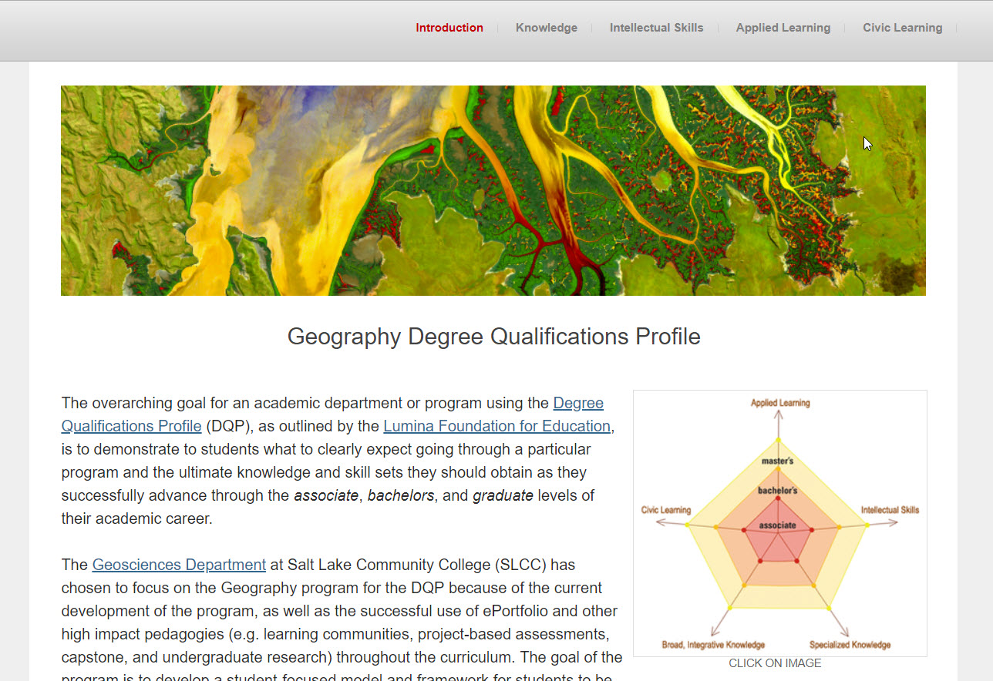
http://degreeprofile.org/
https://geographydqp.weebly.com/
https://www.aacu.org/resources/high-impact-practices

Slide 12
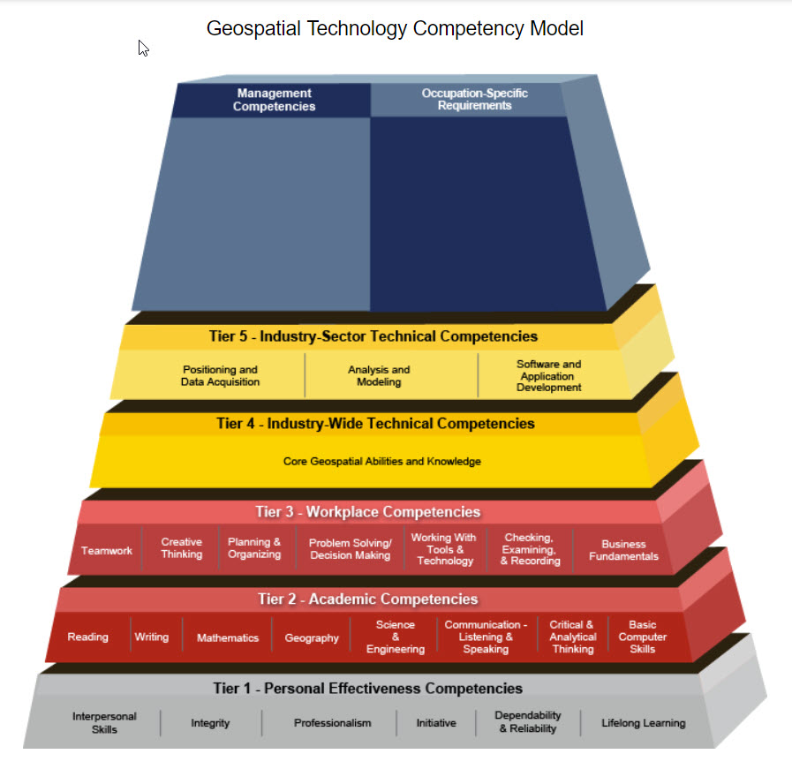
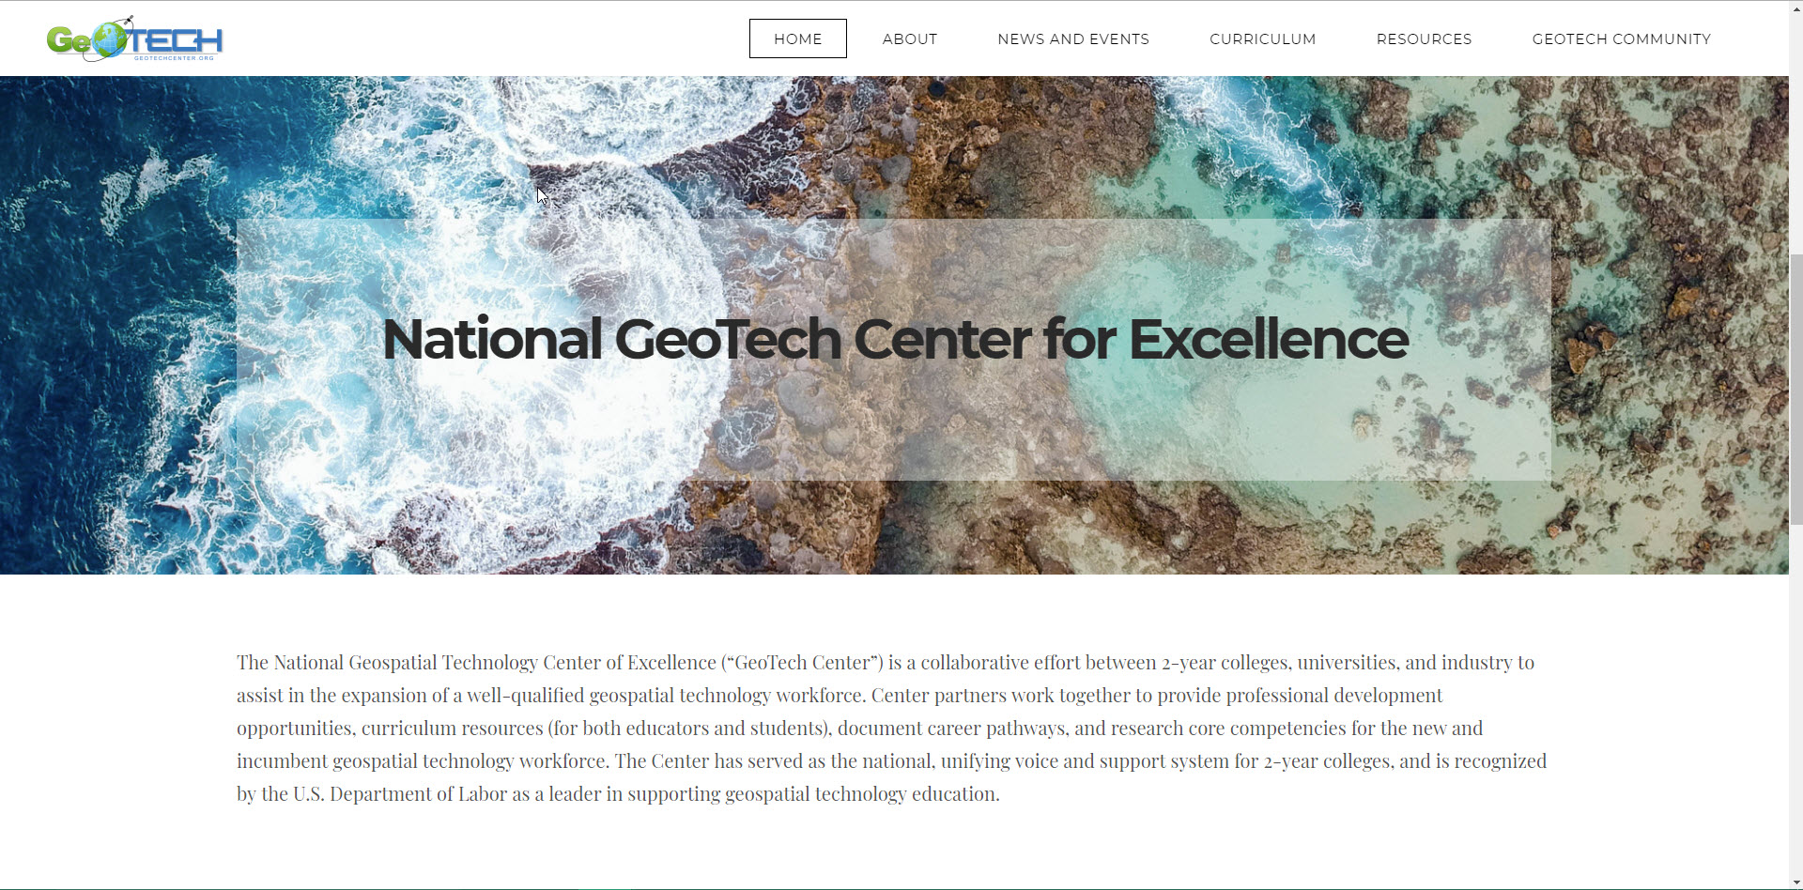
www.geotechcenter.org
GTCM
Curriculum and Model Courses
sUAS Curriculum and Resources (coming soon)
GeoINT Curriculum and Resources (coming soon)
https://tinyurl.com/z2ly5og

Slide 13
R. Adam Dastrup, MA, GISP
Associate Professor, Geosciences
Salt Lake Community College
Senior Researcher, National GeoTech Center
Adam.Dastrup@slcc.edu

